Slide 1
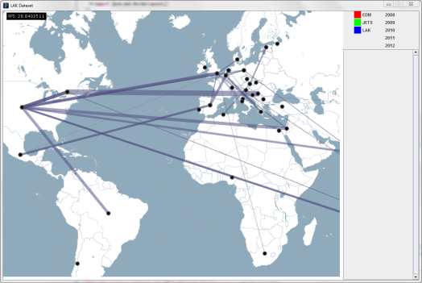
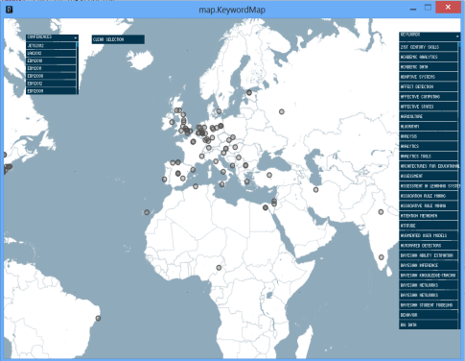
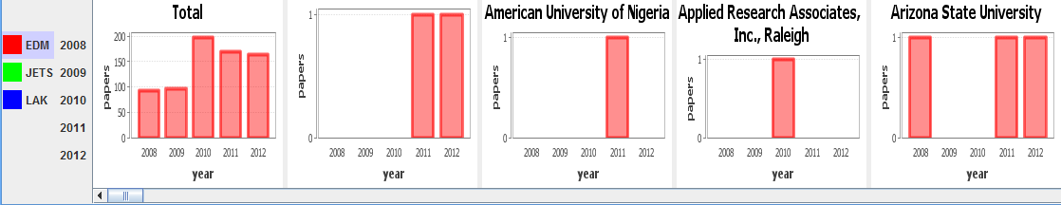
LAK Dataset Visualization – v2
Glenn Croes
Bram Gotink
Geert Van Campenhout
Capita Selecta MMC 2012-13

Slide 2
Contents
Research questions
Possible visualizations
Final choice
Changes in v2
Demo
The Story
Technical details and issues
Lessons learned
Evaluation method

Slide 3

Research questions
Target:
Researchers
Conference organizers
Questions:
What subjects are discussed during this conference? (keywords)
What other organizations are researching a certain subject?
How do conferences evolve over time?
How do conferences compare to each other?

Slide 4
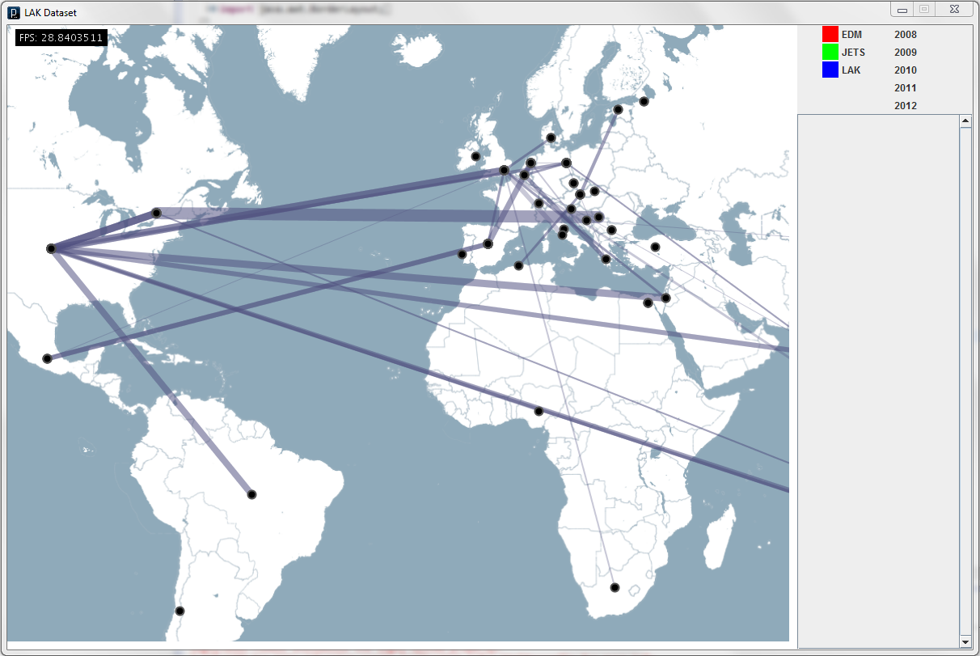
Possible visualizations
Common-paper map
Our original idea
Edges indicate joint research papers between orgs
Thickness indicates amount of common papers
Notes:
Minpunten
- Kan cluttered worden (misschien ook met aggregates werken)

Slide 5
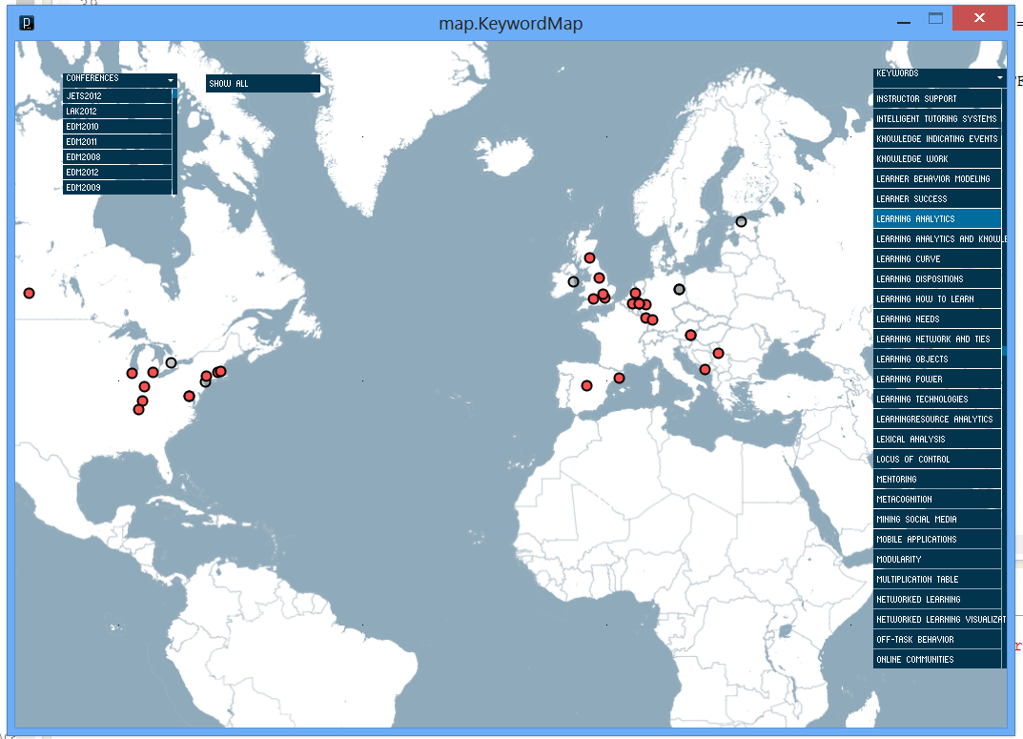
Possible visualizations
Keyword map
List of keywords
Show subjects of conference
Show orgs of subject
Show subjects of org
Notes:
Pluspunten:
+ see what orgs are researching ‘your’ areas of interest
+ get an overview of what conference is about
Minpunten:
Long list of keywords (add search functionality)
Not all papers are properly annotated
No indication of how much research is performed on a certain subject

Slide 6
Possible visualizations
Barcharts to show:
Evolution of #papers conference over time
Evolution of #papers of org over time

Slide 7
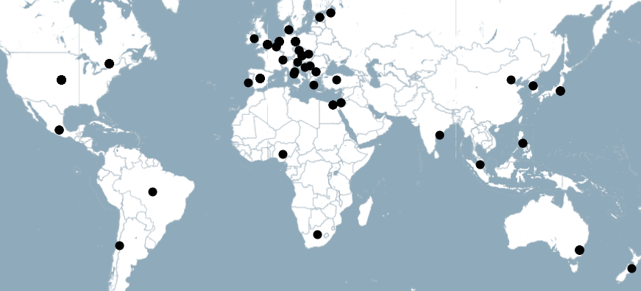
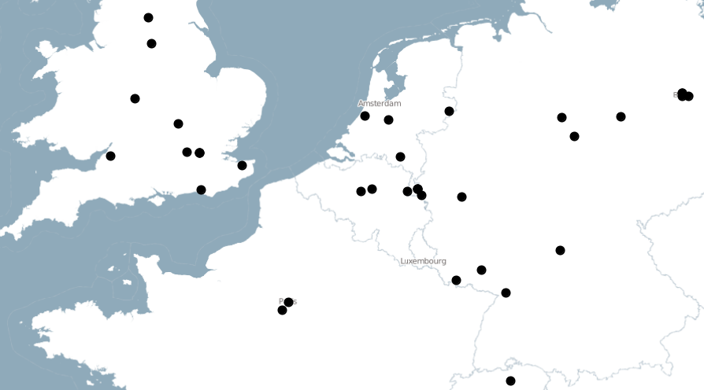
Possible visualizations
Aggregate universities to countries when zoomed out far enough

Slide 8
Final choice
BarCharts + aggregate + common-paper map merged
KeywordMap separate
Keep it that way

Slide 9
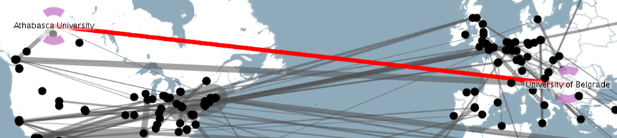
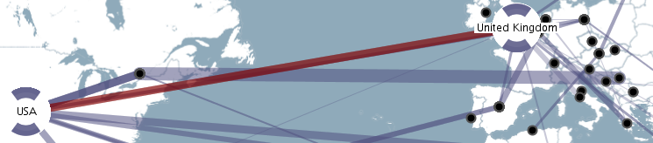
Changes in v2 – Barchartmap
Cached file provider added for performance
Used different colors just for distinctness
Red color less flashy
v1
v2

Slide 10
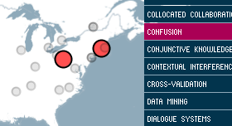

Changes in v2 - Keywordmap
Fixed some selection bugs
Lists now show what is selected
Made it more obvious what organisations are highlighted
Indication when no keywords were found
V2
V1

Slide 11
Demo

Slide 12
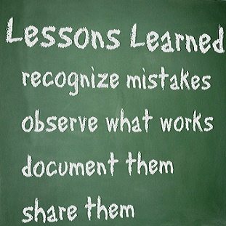
Lessons learned
The hardest part is looking for good questions to ask (with an interesting result or story)
ControlP5 does the trick but is far from ideal
It’s easy to get ‘something’ visualized, but it’s hard to get all the details right

Slide 13

Evaluation method
Expert evaluation
Till
prof. Duval
Joris, other assistants
our fellow students…

Slide 14
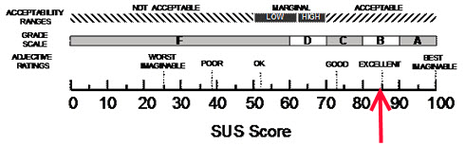
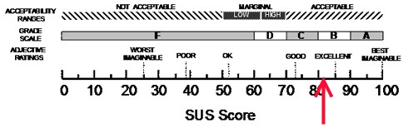
Evaluation
Keywordmap
84.17
Barchartmap
80.83

Slide 15
Changes in v3 – Barchartmap
Added required user interaction
When a bar chart is clicked, the map pans to the corresponding organization/country
When an organization is clicked, the bar charts panel scrolls to the corresponding bar chart

